Slide 1


Data Structures
Lab # 3 Doubly Linked List

Slide 2

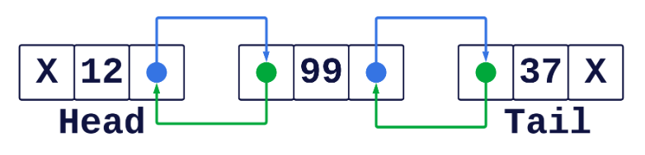
Doubly Linked List
A doubly linked list (DLL) is a type of linked data structure where each node contains three parts:
Data → the actual value to store.
Next Pointer→ the address/reference of the next node.
Previous Pointer → the address/reference of the next Previous.

Slide 3
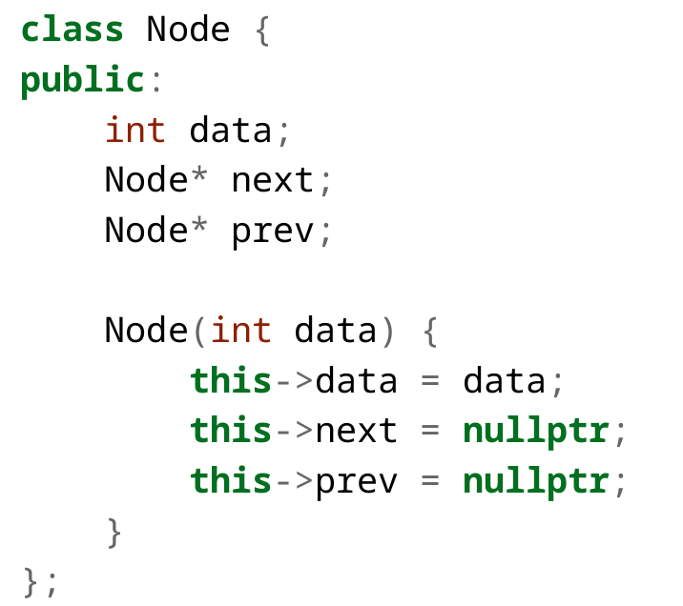
DLL
The type of data that will be stored in a Node in DLL
Next pointer is used to Point to the next Node.
Previous pointer is used to Point to the Previous Node.
Constructor that initialize the members.

Slide 4
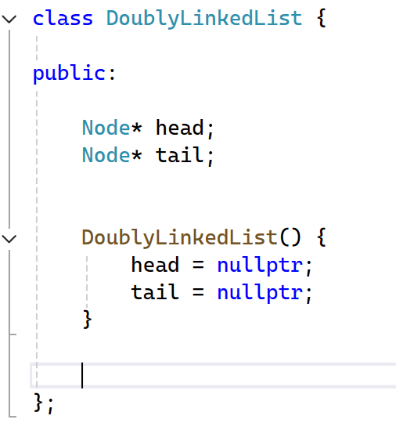
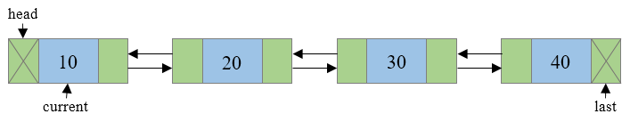
DLL
Pointers to the Node. Start and end of the Linked List
In the constructor, the head pointer is initialized to nullptr, because initially the linked list is empty and no nodes exist.
Notes:
Credit: Linked List Visualizer

Slide 5
DLL
Pointers to the Node. Start and end of the Linked List
In the constructor, the head pointer is initialized to nullptr, because initially the linked list is empty and no nodes exist.
Notes:
Credit: Linked List Visualizer

Slide 6
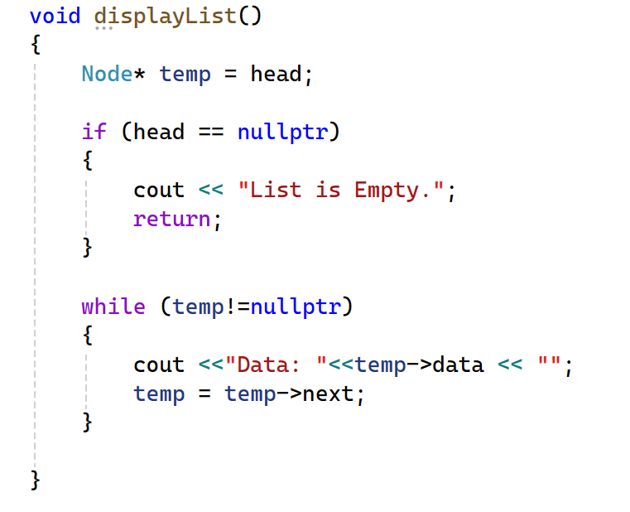
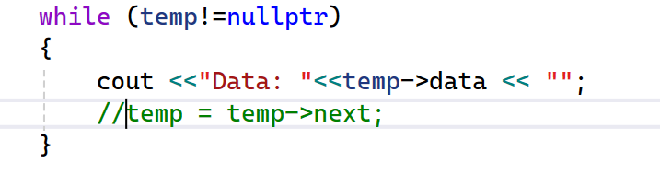
DLL
Do you think we can comment this line and still get the same output?
Notes:
Credit: Linked List Visualizer

Slide 7
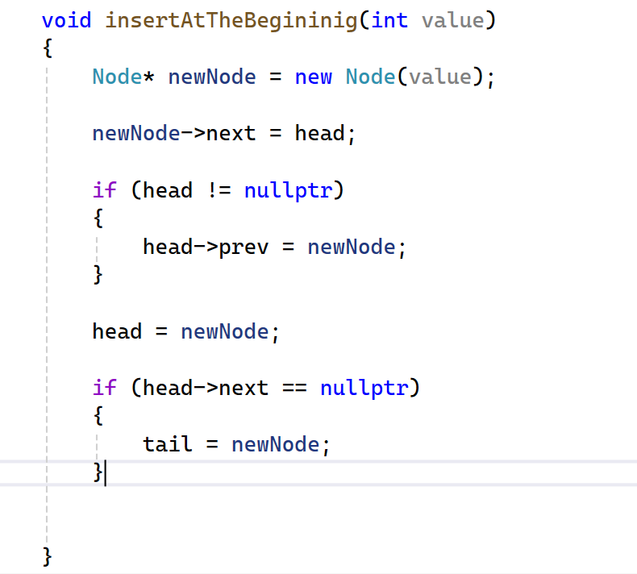
Linked List
Head
Ø
876
Ø
Tail
Ø
876
Ø
000001701A9C1890

Slide 8
Linked List
Head
Ø
Tail
876
Ø
000001701A9C1890
Ø
876
Ø

Slide 9
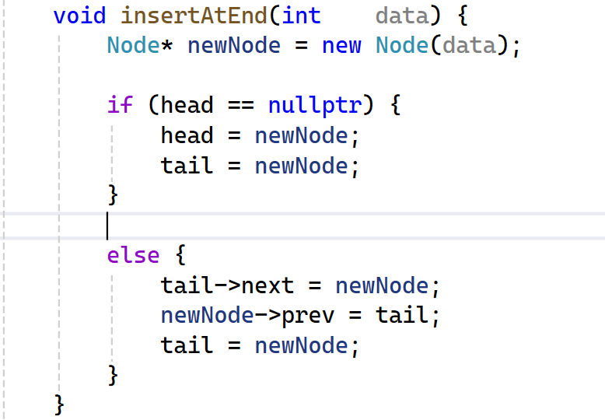
Linked List
Head
Ø
Tail
876
Ø
000001701A9C1890
Ø
876
Ø

Slide 10

THANK YOU!

